Slide 1
Applying reinforcement learning to Tetris
Researcher : Donald Carr
Supervisor : Philip Sterne

Slide 2
What?
Creating an agent that learns to play Tetris from first principles

Slide 3
Why?
We are interested in the learning process.
We are interested in non-orthodox insight into sophisticated problems

Slide 4
How?
Reinforcement learning is a branch of AI that focuses on achieving learning
When utilised in the conception of a digital Backgammon player, TD-Gammon, it discovered tactics that have been adopted by the worlds greatest human players

Slide 5
Game plan
Tetris
Reinforcement learning
Project
  Implementing Tetris
  Melax Tetris
  Contour Tetris
  Full Tetris
Conclusion

Slide 6
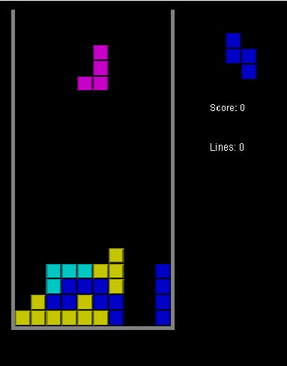
Tetris
Initially empty well
Tetromino selected from uniform distribution
Tetromino descends
Filling the well results in death
Escape route : Forming a complete row leads to row vanishing and structure above complete row shifting down

Slide 7
Reinforcement Learning
A dynamic approach to learning
  Agent has the means to discover for himself how the game is played, and how he wants to play it, based upon his own experiences.
  We reserve the right to punish him when he strays from the straight and narrow
  Trial and error learning

Slide 8
Reinforcement Learning Crux
Agent
  Perceives state of system
  Has memory of previous experiences – Value function
  Functions under pre-determined reward function
  Has a policy, which maps state to action
  Constantly updates its value function to reflect perceived reality
  Possibly holds a (conceptual) model of the system

Slide 9
Life as an agent
Has memory
Has a static policy (experiment, be greedy, etc)
Perceives state
Policy determines action after looking up state in value function (memory)
Takes action
Agent gets reward (may be zero)
Agent adjusts value entry corresponding to state
repeat

Slide 10
Reward
The rewards are set in the definition of the problem . Beyond control of agent
Can be negative or positive : punishment or reward

Slide 11
Value function
Represents long term value of state & incorporates discounted value of destination states
2 approaches we adopt
  Afterstates : Only considers destination states
  Sarsa : Considers actions in current state

Slide 12
Policies
GREEDY : takes best action
ε-GREEDY : takes random action 5% of the time
SOFTMAX : associates a probability of selecting an action proportional to predicted value
Seek to balance exploration and exploitation
Use optimistic reward and GREEDY throughout presentation

Slide 13
The agent’s memory
Traditional reinforcement learning uses a tabular value function, which associates a value with every state

Slide 14
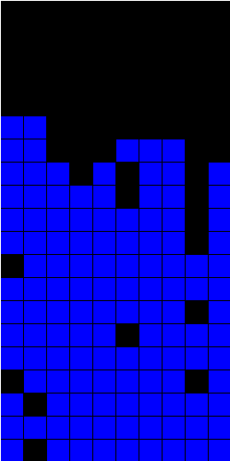
Tetris state space
Since the Tetris well has dimensions twenty blocks deep by ten blocks wide, there are 200 block positions in the well that can be either occupied or empty.
2^200 states

Slide 15
Implications
2^200 values
2^200 vast beyond comprehension
The agent would have to hold an educated opinion about each state, and remember it
Agent would also have to explore each of these states repetitively in order to form an accurate opinion
Pros : Familiar
Cons : Storage, Exploration time, redundancy

Slide 16
Solution : Discard information
Observe state space
Draw Assumptions
Adopt human optomisations
Reduce game description

Slide 17
Human experience
Look at top well (or in vicinity of top)
Look at vertical strips

Slide 18
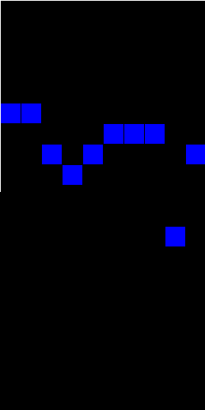
Assumption 1
The position of every block on screen is unimportant. We limit ourselves to merely considering the height of each column.
20^10 ≈ 2^43 states

Slide 19
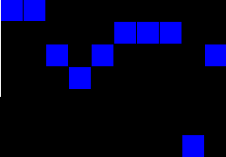
Assumption 2
The importance lies in the relationship between successive columns, rather then their isolated heights.
20^9 ≈ 2^39 states

Slide 20
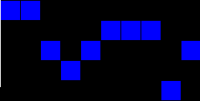
Assumption 3
Beyond a certain point, height differences between subsequent columns are indistinguishable.
7^9 ≈ 2^25 states

Slide 21
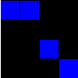
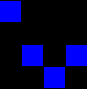
Assumption 4
At any point in placing the tetromino, the value of the placement can be considered in the context of a sub-well of width four.
7^3 = 343 states

Slide 22
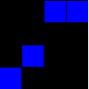
Assumption 5
Since the game is stochastic, and the tetrominoes are uniformly selected from the tetromino set, the value of the well should be no different from its mirror image.
175 states

Slide 23
You promised us an untainted non-prejudice player but you just removed information it may have used constructively
Collateral damage
Results will tell

Slide 24
First Goal : Implement Tetris
Implemented Tetris from first principles in java
Tested game by including human input
Bounds checking, rotations, translation
Agent is playing an accurate version of Tetris
Game played transparently by agent

Slide 25
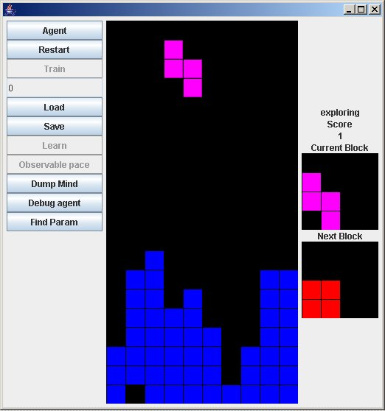
My Tetris / Research platform

Slide 26
Second Goal : Attain learning
Stan Melax successfully applied reinforcement learning to reduced form of Tetris

Slide 27
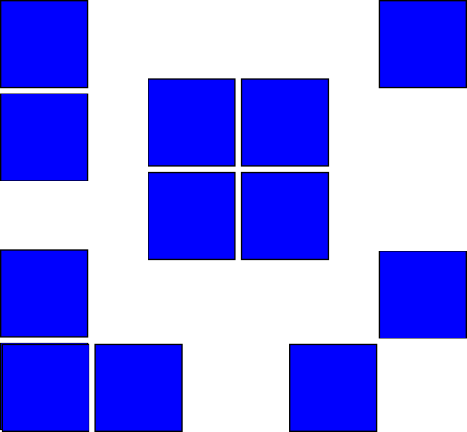
Melax Tetris description
6 blocks wide with infinite height
Limited to 10 000 tetrominoes
Punished for increasing height above working height of 2
Throws away any information 2 blocks below working height
Used standard tabular approach

Slide 28
Following paw prints
Implemented agent according to Melax’s specification
Afterstates
  Considers value of destination state
  Requires real time nudge to include reward associated with transition
  This prevents agent from “chasing” good states

Slide 29
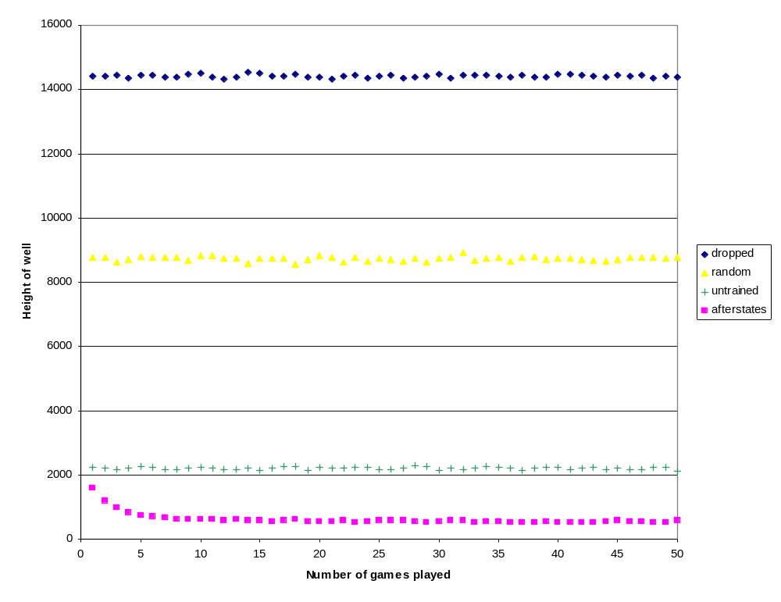
Results (Small = good)

Slide 30
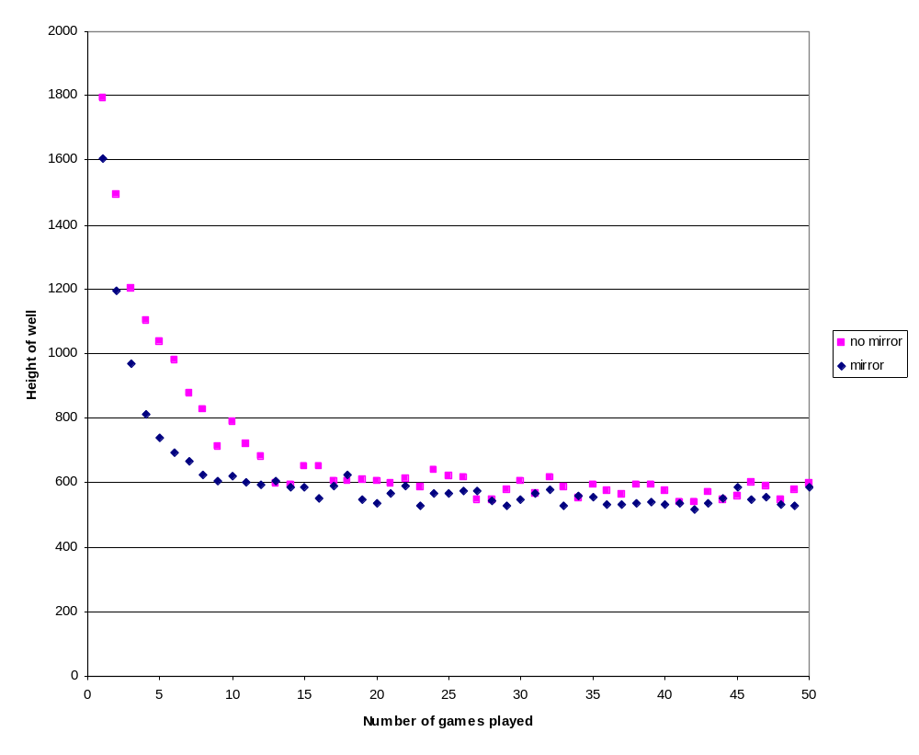
Mirror symmetry

Slide 31
Discussion
Learning evident
Experimented with exploration methods, constants in learning algorithms
Familiarised myself with implementing reinforcement learning

Slide 32
Third Goal : Introduce my representation
Continued using reduced tetromino set
Experimented with two distinct reinforcement approaches, afterstates and Sarsa(λ)

Slide 33
Afterstates
Already introduced
Uses 175 states

Slide 34
Sarsa(λ)
Associates a value with every action in a state
Requires no real-time nudging of values
Uses eligibility traces which accelerate the rate of learning
100 times bigger state space then afterstates when using the reduced tetrominos
State space : 175*100 = 17500 states
Takes longer to train

Slide 35
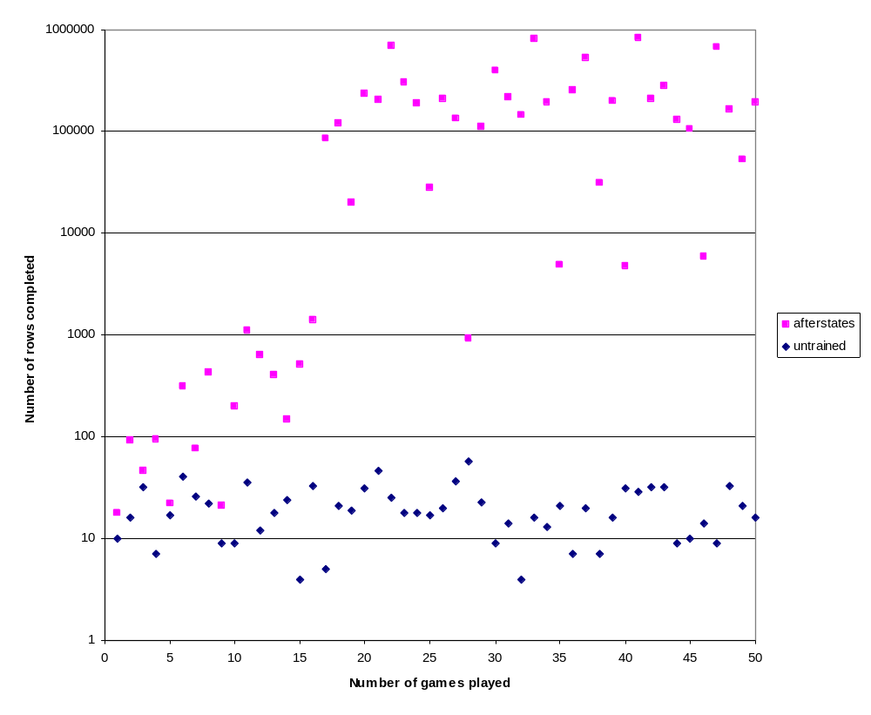
Afterstates agent results (Big = good)

Slide 36
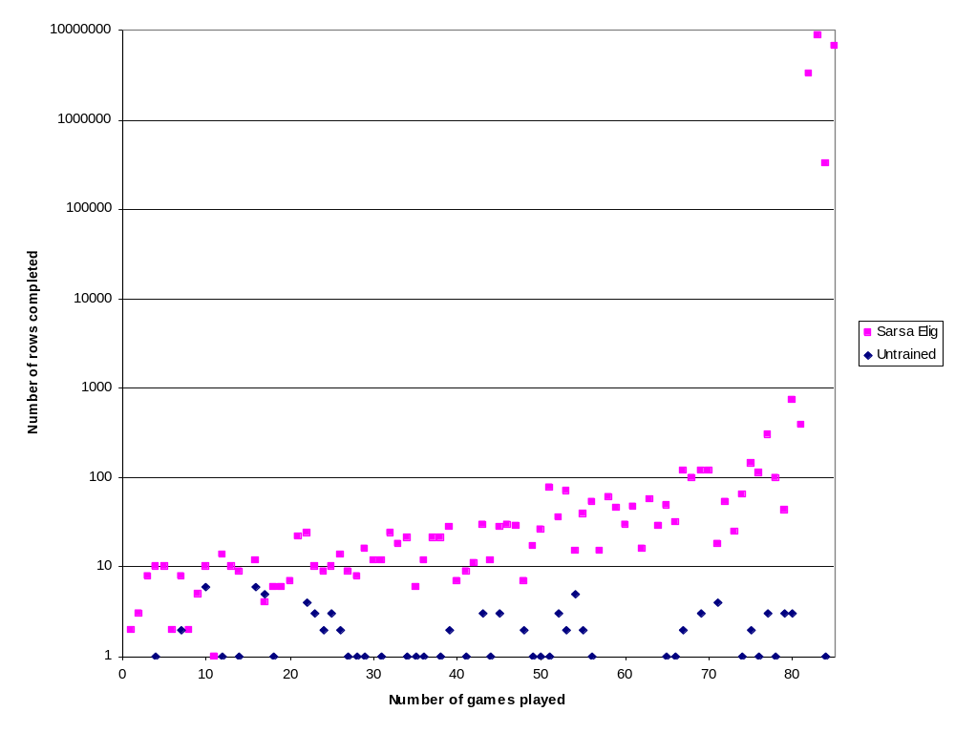
Sarsa agent results

Slide 37
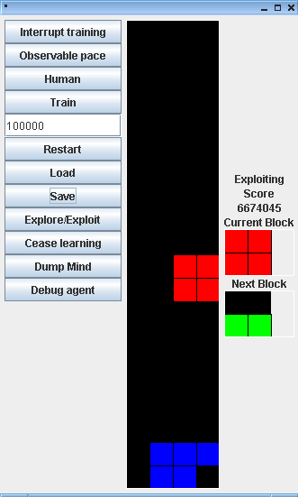
Sarsa player at time of death

Slide 38
Final Step : Full Tetris
Extending to Full Tetris
Have an agent that is trained for sub-well

Slide 39
Approach
Break the full game into overlapping sub-wells
Collect transitions
Adjust overlapping transitions to form single transition
  Average of transitions
  Biggest transition

Slide 40
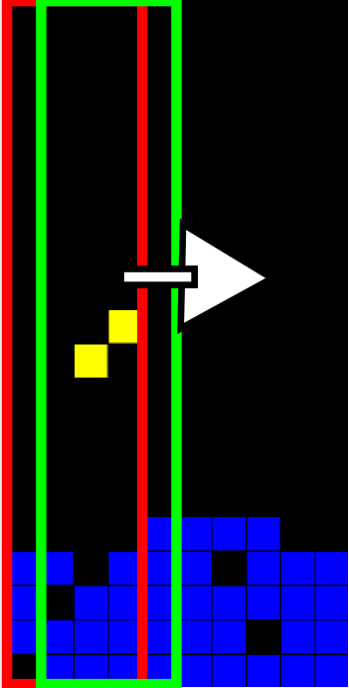
Tiling

Slide 41
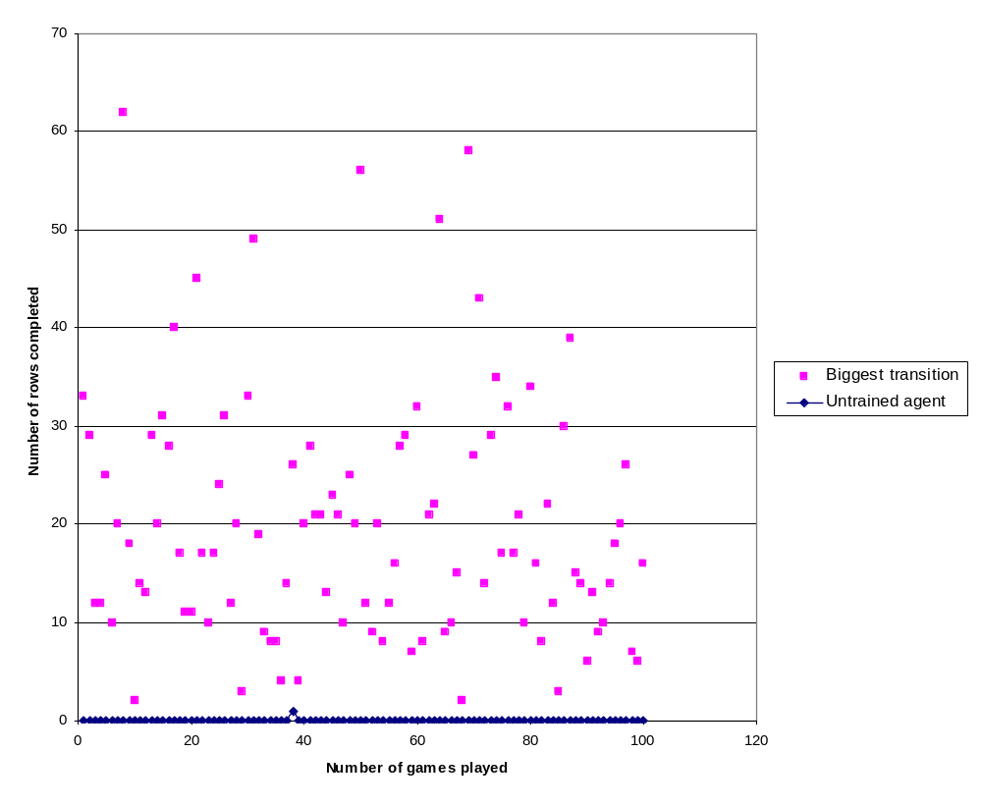
Sarsa results with reduced tetrominos

Slide 42
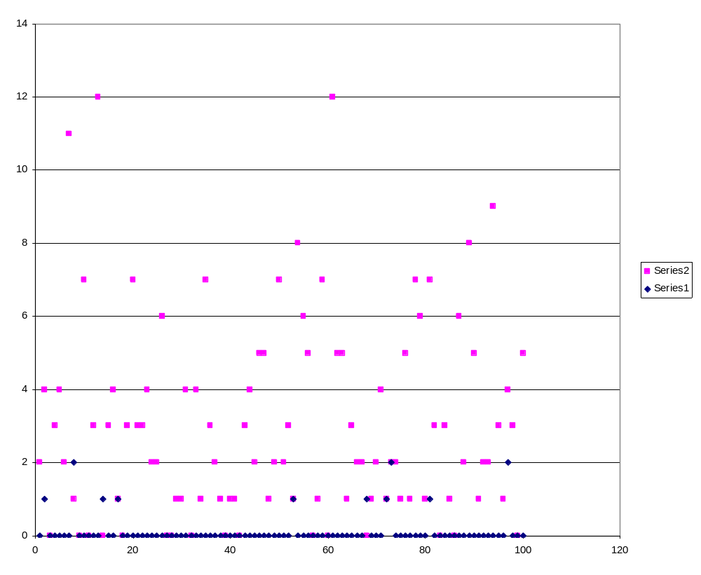
Afterstates results with reduced tetrominos

Slide 43
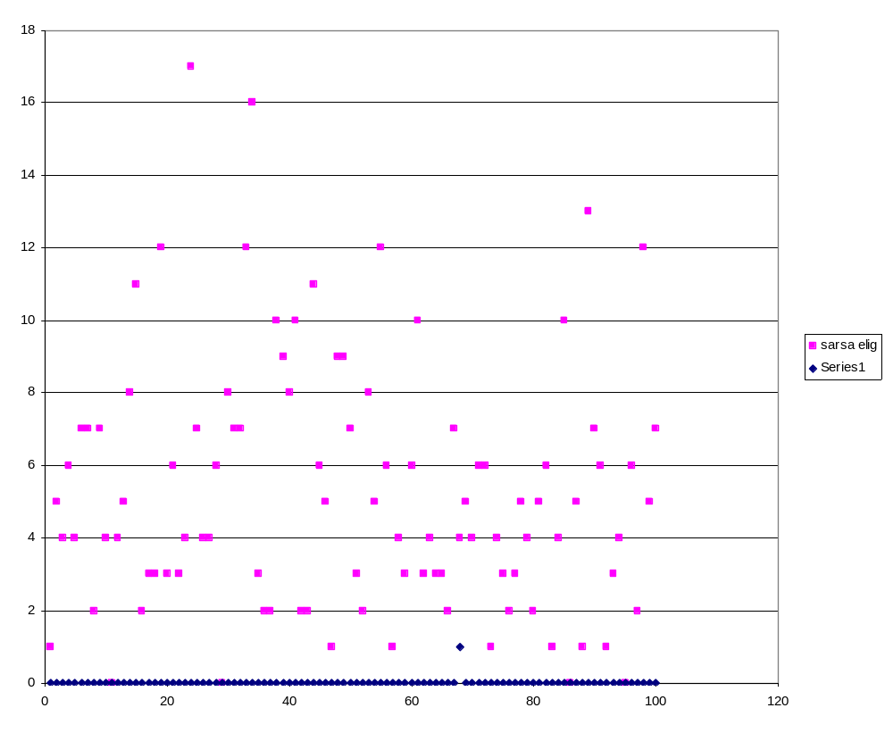
Sarsa results with full Tetris

Slide 44
In conclusion
Thoroughly investigated reinforcement learning theory
Achieved learning in 2 distinct reinforcement learning problems, Melax Tetis and my reduced Tetris
Successfully implemented 2 different agents, afterstates and sarsa
Successfully extended my sarsa agent to the full Tetris game, although professional Tetris players are in no danger of losing their jobs

Slide 45
Departing comments
Thanks to Philip Sterne for prolonged patience
Thanks to you for 20 minutes of patience

